Slide 1
SENIOR PARENT INFORMATION MEETING
Helping your seniors take the next step into their future
CLASS OF 2018
Presented by
Campbell High School
School Counseling Department

Slide 2
Administrator Assignments
Dr. Walker – Principal
A Mr. Penick
B-C Mrs. Moore-Williams
D-G Mr. Ford
H-K Dr. Lockhart
L-N Dr. Hutson
O-R Ms. Hayden
S-Z Mr. Defreezer
9th A-L Ms. Andrews
9th M-Z Ms. Sharp
No Discipline Ms. Willis
CLASS OF 2018

Slide 3
Professional Counselor Assignments
A-Bo Mrs. Burke-Collins
Br-F Mrs. Ellison-Brown
G-K Dr. Amand
L-Pa Mrs. Wright
Pe-Sam/ESOL/AVID Mrs. Schloemer-Bryant
San-Z Mrs. Jackson
Registrar/Dual Enrollment Mrs. Loftin
Follow us
@CounselorSparta “Campbell HS Counseling” page
Remind 101 – text @gafa78 to 81010
CLASS OF 2018

Slide 4
Topics to be discussed
Senior Seminar Sessions
Opportunities & Costs
Graduation Requirements
Post-Secondary Options
NCAA/NAIA Athletics
Parental Stumbling Blocks
College Application Process/Visits
Financial Aid & Scholarships
Upcoming Events
Test Reminders
CLASS OF 2018

Slide 5
Senior Seminar Sessions
In early September, counselors met with seniors in large groups and discussed the following:
Post-secondary options
(Employment, Military and College)
College Application Process
Requesting Transcript
Testing
Financial Aid
College Visits (On/Off Campus)
Career Center After Dark
CLASS OF 2018

Slide 6
Herff Jones
Cap and Gown rental fee is $74.20 by December 15th
Late fee added after December 15th
Contact Information: 770-795-1626
The longer you wait, the more expensive it becomes
Website: www.herffatlanta.com
CLASS OF 2018

Slide 7
SENIOR PICTURE/YEARBOOK INFORMATION
To be included in yearbook:
- Senior portraits must be taken by December 1st
- Appointments can be booked online at cadystudios.com
- There will be a $30 sitting fee – due at the time pictures are taken
Yearbooks are $60 until January 22nd
- After that date, the price goes up to $70
- Add $5 for a nameplate
- Deadline to purchase will be March 20, 2018
- You can place your order online at: yearbookordercenter.com (order # 14074) or pay by cash or check in room 936 after- school.
CLASS OF 2018

Slide 8
Senior Dues
Senior dues are $50.00 (Can be paid to Mr. Smith in room 917 or Ms. Campbell in 404)
Includes class t-shirt, long-sleeved hoodie, fall & spring events and all activities/food during senior week
Must be paid in order to participate in senior activities
CLASS OF 2018

Slide 9
Senior Activities
November 13th – Skate Night
November 17th – Senior class group picture (Wills Gym)
March 12-16th – Senior Week
March 17th - Prom
Senior Trip - April 12th – 14th
($295 – includes transportation, lodging, tickets to Aquatica with one meal and Universal Studios)
More information can be found at: www.campbellseniortrip.weebly.com
Senior Trip deposit of $110 is due by November 16th to Ms. Campbell in room 404
May - Senior Picnic after Graduation Practice
Please sign up for Remind @kca9k2 to 81010 for information on upcoming events/activities

Slide 10
GRADUATION REQUIREMENTS
The requirements below represent minimal courses needed for high school graduation. A GPA of 3.5 or higher is required to be an honor graduate.
Subject | Units | Required Courses
English | 4 | 9th Lit., World Lit., American Literature, 4th English
Math | 4 | Algebra, Geometry, Algebra II & 4th Math
Science | 4 | 1 unit of Biology 1 unit of Environmental Science or Chemistry or AP Science or Earth Systems 1 unit of Physics or Physical Science 4th Science may be used to meet both elective and science requirements
Social Studies | 3 | 1 unit World History 1 unit U.S. History ½ unit Economics ½ unit American Government
CTAE, Foreign Language, Fine Arts | 3 | This area can be a combination: 3 units are required
Health/Personal Fitness | 1 | .5 unit of Health .5 unit of Personal Fitness
Electives | 4
Total | 23 | Course Specific Credits are required for graduation

Slide 11
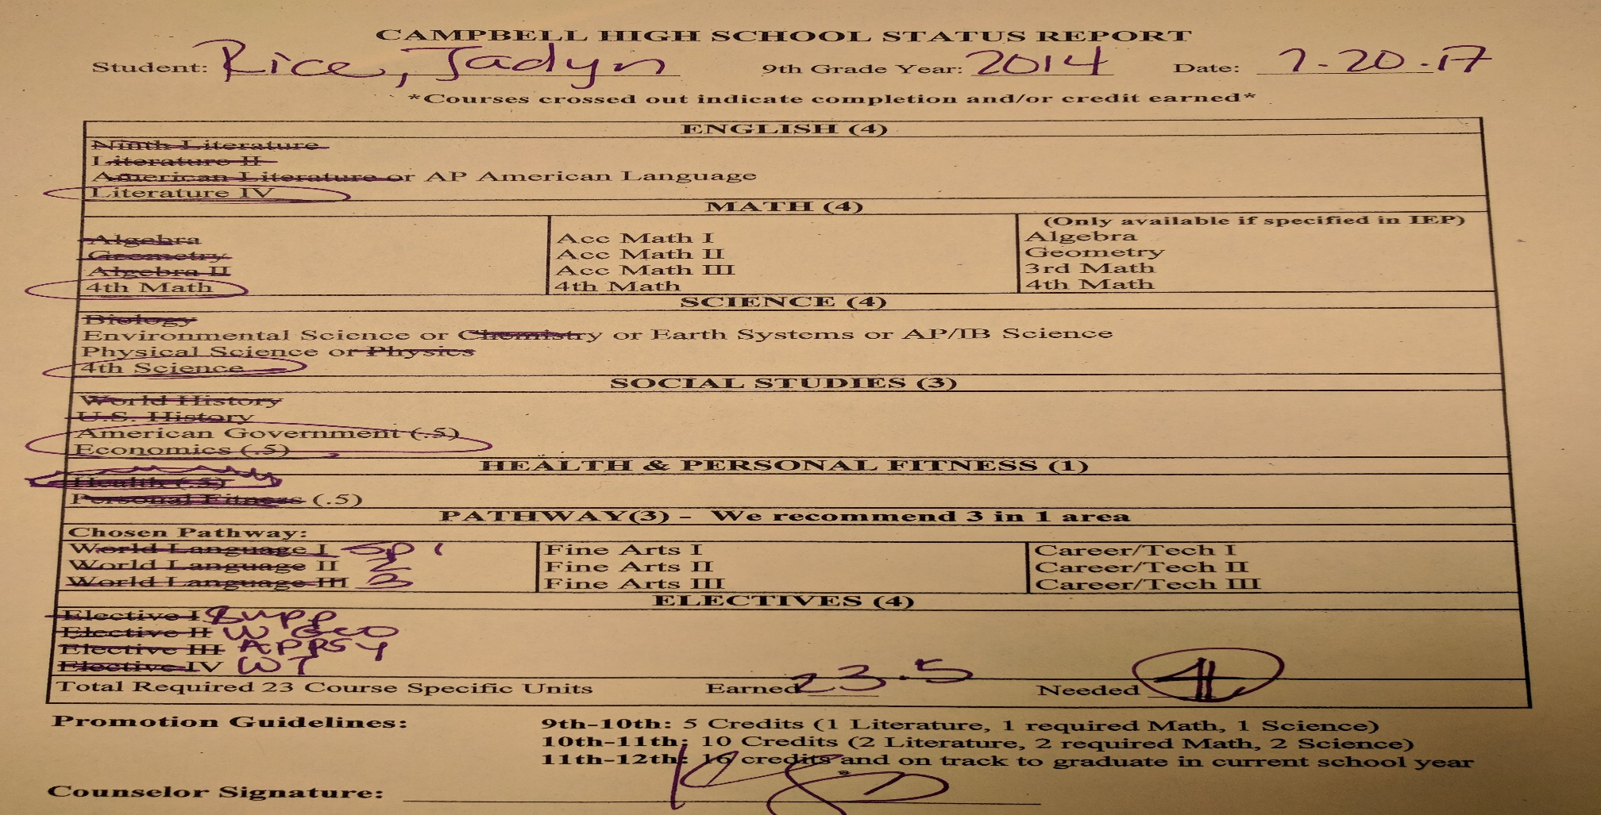
Is My Student on Track?
Status reports and transcripts were mailed home in July & given to students 1st week in homeroom
If your student is failing required classes in the spring, you will receive written notification
CLASS OF 2018

Slide 12
HEADED
IN THE
RIGHT DIRECTION??
CLASS OF 2018

Slide 13
Post Secondary Options
Can Include
Traditional 4-year colleges/universities
2 year colleges for associates degree or to transfer to a 4-year college/university
Technical Colleges
Professional Training Programs
Military
Work
Which is appropriate for your student?
CLASS OF 2018

Slide 14
Factors to Consider When Choosing a College
Major or Program of study
Location and Environment
In-state vs. Out-of-state
Public vs. Private
Size of School
Extracurricular Activities Offered
CLASS OF 2018

Slide 15
How Do I Learn More About Schools?
Research
- careercruising.com, gafutures.org, collegeboard.org
Meet with College Reps when they visit
On-site campus visits
Open houses sponsored by colleges
Internet
Attend college fairs in the area
CLASS OF 2018

Slide 16
How Do Colleges Choose Who Will Be Accepted?
High school academic record and course rigor (GPA/Class Rank)
SAT/ACT/ACCUPLACER scores
Essays **
Recommendations **
Special Abilities
Service to school or community
Extracurricular activities
Interview **
** Not required by all colleges/universities

Slide 17
Don’t Put All Your Eggs In One Basket!
Students need to apply to more than one college/university. Typically students apply to 3-5.
Reach Schools – your core GPA and test scores are BELOW the college freshmen profile
Target Schools—your core GPA and test scores MATCH the college freshmen profile.
Safety School – your core GPA and test scores are ABOVE the college freshmen profile
CLASS OF 2018

Slide 18
Interested in College Athletics?
Two Governing Bodies
NAIA – National Association of Intercollegiate Athletics – no national clearinghouse, simple requirements www.naia.org
NCAA – National Collegiate Athletic Association – requires potential Division 1 and 2 student athletes to register at ncaaclearinghouse.com
- Process for both requires: Transcript, SAT/ACT & $80 registration fee (unless waiver for testing was used)
Please note that it is the parent’s or student’s responsibility to register
CLASS OF 2018

Slide 19
Parental Stumbling Blocks
Dictating exactly where your student must apply and attend
Completing your student’s applications!!! Give them ownership of their future.
Doing all the work for your student doesn’t teach him/her the coping skills needed for college or in life!
CLASS OF 2018

Slide 20
The College
Application Process
CLASS OF 2018

Slide 21
College Application Process
Apply to colleges either online or by traditional method (on-line is preferred)
* For in-state colleges, students can apply by going to www.gafutures.org. You must create an account, before using this site.
Apply early and organize your deadlines
Professional email addresses are a MUST! Include some form of your name and exclude nicknames, slang, etc.
Request letters of recommendations at least 2 weeks in advance of due date.
CLASS OF 2018

Slide 22
College Application Process, cont.
Create a résumé
Compose essays
Make copies of everything you send out
Transcripts for in-state colleges can be requested on gafutures.org for FREE!
There is a $2 charge per transcript for out-of-state colleges and if you request them in person
See your counselor if your college requires a counselor/school evaluation form – 2 week notice
The counseling department does not mail out applications
CLASS OF 2018

Slide 23
Apply to College Day
This event will be held on January 26th
Opportunity to apply to colleges with the assistance of all counselors and some college admissions representatives
Details forthcoming
CLASS OF 2018

Slide 24
Remember…
Colleges/Universities require SAT/ACT scores to come directly from the testing agency!
SAT - $13.00/additional score report requested
ACT - $13.00/additional score report requested

Slide 25
Letters of Recommendation
Request letter of recommendation from – teachers, counselors, coaches, and/or employers
For counselors – fill out survey link on our website
Double check application instructions. If the school does not ask for letters, then do not send them! (Could show that you do not follow instructions)
Request letters at least two full weeks in advance of deadline date.
Give a hand-written thank you card/letter to the person(s) for writing these letters for you. This goes a long way ☺!
CLASS OF 2018

Slide 26
After Applying – What’s Next?
Accepted (Hooray!!)
Celebrate
Send Deposits
Deferred
Still in the game. Send mid-year grades and additional required components!
Evaluate back-up plan
Denied (Reasons)
Poor academic performance
Dual Enrollment GPA below 2.0
Dropped classes you said you were taking when you applied
Not checking email (please check regularly to receive updated information from the admissions office. This is their method of connecting with you
* ALL colleges/universities request that students let them know if they do not plan to attend their institution. An email is appreciated and may allow an opportunity for a student on the deferred list.

Slide 27
Off-Campus College Visit Procedures
Please be aware of the following guidelines
with regard to absences as a result of these visits:
Parent note outlining destination & dates student will be absent needs to be submitted to the attendance office AT LEAST 5 school days prior to absence.
Absence(s) will be excused if official documentation from the institution, including dates & times of tours, appointments with admissions counselors, etc. is submitted to attendance office upon return to school. Brochures & campus maps will not qualify as appropriate/sufficient documentation of a college visit.

Slide 28
Financial Aid and Scholarship Information
CLASS OF 2018

Slide 29
Scholarship Information
A monthly newsletter containing updated scholarship information is emailed & posted on our website
If you have any questions about scholarships, please contact Mrs. Wright at: yolanda.wright@cobbk12.org
CLASS OF 2018

Slide 30
How do I Find $$$ for College
Scholarship listing on our website
Research
Colleges and Financial Aid offices
FAFSA and CSS Profile
Websites:
- fastweb.com
- gafutures.org for special state and federal grants
CLASS OF 2018

Slide 31
Scholarship Search Services
We follow the guidelines set forth by the Georgia Student Finance Commission (GSFC) and recommend that you DO NOT use a scholarship search service.
The same resources that you will be charged in excess of $500 are available for FREE!
CLASS OF 2018

Slide 32
Georgia’s HOPE Program
All HOPE programs require students to:
Be a legal resident of Georgia
Be registered with Selective Service, if male
Be in compliance with the Georgia Drug-Free Post-secondary Education Act of 1990
Meet HOPE’s US citizenship or eligible non-citizen requirements
Attend an eligible Georgia school
To see the full list of program requirements, visit www.gafutures.org

Slide 33
HOPE GPA Requirements
HOPE Scholarship
Earn a 3.0 GPA in high school (calculated by GA Student Finance Commission)
Recipients must have 3.0 GPA at checkpoints to maintain scholarship
HOPE Grant
Grant—available to students who are seeking a technical certificate or diploma, regardless of student’s high school grade point average or gradation date.
Zell Miller Scholarship
Graduate valedictorian or salutatorian
Earn a 3.7 GPA in high school AND earn a 1200 combined score or reading and math on a single administration of the SAT or a 26 composite score on a single administration of ACT by your graduation date.
Recipient must have a 3.3 GPA at checkpoints to maintain scholarship.
Please make sure that we have the correct social security number on file. You will not receive HOPE funds without it

Slide 34
HOPE Rigor Courses
English/ELA
AP Language, AP Literature
Mathematics
AMDM, Adv Alg/Alg 2
Acc Pre-Calculus, Pre Calculus
AP Calculus AB/BC, AP Stats
Social Studies
AP Psychology, AP Gov/Econ
AP Human Geography
AP World History
AP U.S. History
European History
Science
AP Computer Science
AP Biology, AP Env. Science
Human Anatomy
Chemistry, AP Chemistry
Physics, AP Physics
World Language
French II, II, IV, V, AP
Spanish II, III, IV, V, AP
Latin II, III, IV, AP
Japanese II, III, IV, V, AP
Amer. Sign Language II, III
Class of 2018 must earn at least four (4) credits from this list above
CLASS OF 2018

Slide 35
Hope Grant & Governor’s Strategic Funding Grant
HOPE Grant
Hope Grant - Funding from the State for ANY certificate program at a Georgia Technical College
No GPA admission requirement
Apply via FAFSA
Governor’s Strategic Funding Grant
Covers majority of all fees for the following programs (students pay < $100)
Diesel Mechanic Early Childhood
Welding Commercial Truck Driving
Practical Nursing Computer Info Systems
(lack of employers in these industries)

Slide 36
How to Check your current HOPE GPA
Go to www.gafutures.org
Under “News You Can Use,” click on Shortcuts
Click Your HOPE GPA
Sign in or create your account
Follow directions to get your HOPE GPA.
CLASS OF 2018

Slide 37
Career Center After Dark
November 6th
February 5th
March 5th
April 9th
The Career Center will be open from 3:30 – 5:00 pm
CLASS OF 2018

Slide 38
Lunch & Learn
November 15th – College Applications
January 31st – Scholarships & Financial Aid
April 25th – FAFSA & How to Understand Your Student Aid Report
* Sessions take place on Wednesdays
* Students need to sign up in the counseling office
CLASS OF 2018

Slide 39
Future Fridays
Presentations of various careers by the professionals themselves
November 3rd – Entrepreneur
November 10th – Medical Doctor
January 12th – Lawyer
February 2nd – Graphic Designer
* Space is limited to 20 spots!
* Sign up in the school counseling office

Slide 40
Test Reminders
SAT
Collegeboard.org
ACT
actstudent.org
(Can use waivers for ACT & SAT if you are on free or reduced lunch)
ACCUPLACER Exam (must contact institutions directly for scheduling)
ASVAB (Feb or March, 2018) at CHS
CLASS OF 2018

Slide 41
Final Thoughts
Watch all deadlines!!!
Finish Strong
Use your senior year as a start to your freshman year of college
- Academic rigor should be increased, not decreased
Scholarships are hard work, but it is FREE money!!!
CLASS OF 2018

