Slide 1
Freshman Focus

Slide 2
CHS School Counselors and Staff
A-Bo: Mrs. Burke-Collins
Br-F: Mrs. Ellison-Brown
G-K: Dr. Amand
L-Pa: Mrs. Wright
Pe-Sam/AVID/ESOL: Mrs. Schloemer Bryant
San-Z: Mrs. Jackson
Dual Enrollment/Registrar: Mrs. Loftin
Counseling Intern: Mrs. Beasley
Graduation Coach: Dr. Hays
Social Worker: Ms. Fain
College & Career Consultant: Ms. Janet Ndah
Counseling Desk Clerk: TBA
Records Clerk: Mrs. Askew

Slide 3
Let’s Discuss
GPA
The Importance of Course Rigor
Transcripts
Promotion Requirements
Graduation Requirements
Dual Enrollment
Responsibilities in the Classroom

Slide 4
What’s a GPA and Who Cares?
Letter Grade | Grade Points | Numeric Grade
A | 4.0 | 90-100
B | 3.0 | 80-89
C | 2.0 | 74-79
D | 1.0 | 73-70
F | 0.0 | 69 and ↓
Different kinds of GPA
Weighted and Unweighted (Cumulative)
Core
HOPE
College
Weighted GPA determines class rank

Slide 5
GPA Examples
Example 1
3.0 + 4.0+ 3.0+ 3.0= 13
13/4 = 3.25 GPA
Example 2
2.5 + 3.5+ 3.0+ 4.0= 13
13/4 = 3.25 GPA
Algebra I | B | 3.0
World Geography | A | 4.0
Intro to Drafting | B | 3.0
Art | B | 3.0
H Algebra I | C | 2.5
H World Geography | B | 3.5
Intro to Drafting | B | 3.0
Art | A | 4.0

Slide 6
Why take Honors and AP classes?

Slide 7
Why take Honors and AP classes?
Provides opportunities to improve study skills
Familiarizes you with college level work
Can boost your cumulative GPA and class rank
Prepares you for big tests (ACT, SAT, ASVAB, Accuplacer, Milestones)
Gives you an advantage in college admissions
Allows you to expand your interests
May be eligible for college credit (AP Exam)
Improves work ethic and critical thinking skills for workforce

Slide 8
Report Card v. Transcript
Report Card
Transcript
Grades from one semester
Unofficial document
Used by parent or guardian
Includes some personal information (address, Cobb ID)
Record of all high school final grades
Official legal document
Used by colleges, military, and employers
Includes identifying personal information (DOB, address, state ID)
Includes class rank & cumulative GPA

Slide 9
What does your transcript say about you?
Your cumulative GPA
Your class rank
Rigor or level of difficulty of courses
Courses that count toward your HOPE GPA
Graduation requirements
Attendance

Slide 10
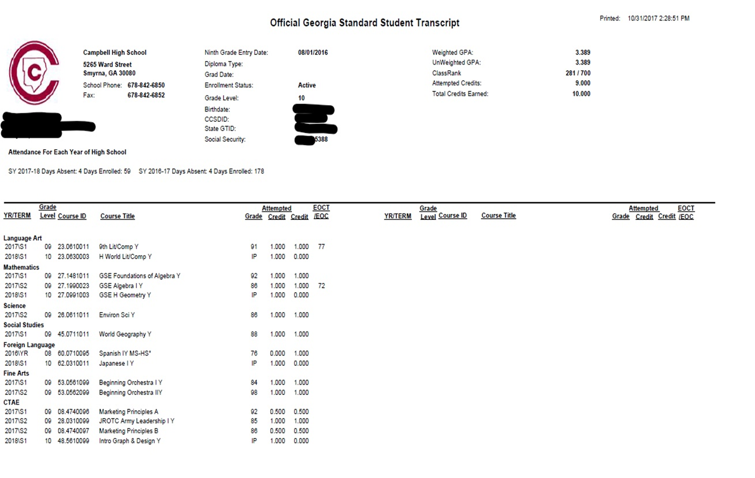

Slide 11
Graduation Requirements
*23 units Required for graduation!
4 units English (Ninth Lit and American Lit)
4 units Math (Algebra I, Geometry, Algebra II)
4 units Science (Biology, Physics, Environmental Science or Chemistry)
3 units Social Studies (World History, US History, American Govt/Econ)
½ unit Health
½ unit Personal Fitness
3 units Career Tech/World Language/Fine Arts (pathway completion encouraged)
4 units General Electives

Slide 12
Promotion Requirements
Promotion Requirements:
9th to 10th: 5 credits (1 credit each in required or core Lit, math, science)
10th to 11th: 10 credits (2 credits each in required or core Lit, math, science)
11th to 12th: 16 credits and have met all other promotion requirements
EOC/Milestones count as 20% in certain courses

Slide 13
Career Pathways
Audio Video Tech
Army JROTC
Early Childhood Education
Plant Science/Horticulture
Graphic Communication
Culinary
Engineering
Digital Design
Programming
Marketing
Fashion, Marketing, and Retail
Public Safety

Slide 14
Being Successful in High School
Basic Requirements
Going Above and Beyond
Come to school regularly
Be in class on time
Have your materials
Pay attention in class
Complete and submit your assignments on time
Find out what you missed when absent and make up work in a timely manner
Check your grades
Review & preview notes
Attend tutoring
Communicate with your teacher
Take detailed notes
Study nightly
Keep a calendar
Stay organized

Slide 15
Dual Enrollment
Dual Enrollment, formerly Move On When Ready (MOWR), is a Georgia program that allows high school students to earn college credit while working on their high school diploma.
The program covers tuition, mandatory fees and required textbooks.
The goal is to increase college access and completion, and prepare students to enter the workforce with the skills they need to succeed.

Slide 16
Career Cruising

Slide 17
Career Cruising
Take a career interest inventory
Match your interests to a career
Explore careers
Listen to personal stories from people in careers
Find out what type of school or training is needed for careers
Find out what a career pays
Save 3 careers to their portfolio

Slide 18
Resources
Parentvue
Tutoring (Teacher, Department, Student Clubs and Organizations)
Power Surge
Credit Recovery (Course Extension, After school Gradpoint, CVA, Summer School)
After school STEM program
Khanacademy.org (for homework help and test practice)
Gafutures.org
Careercruising.com (students have logins and can send parents invitation for an account)
Collegeboard.org

Slide 19
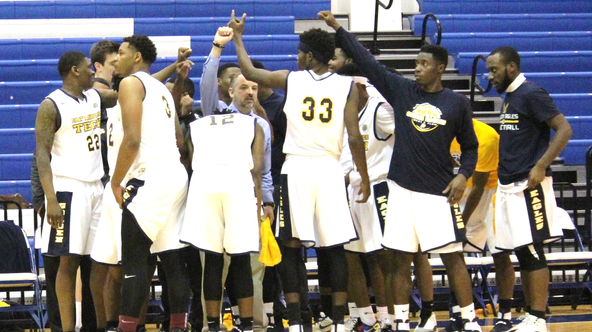
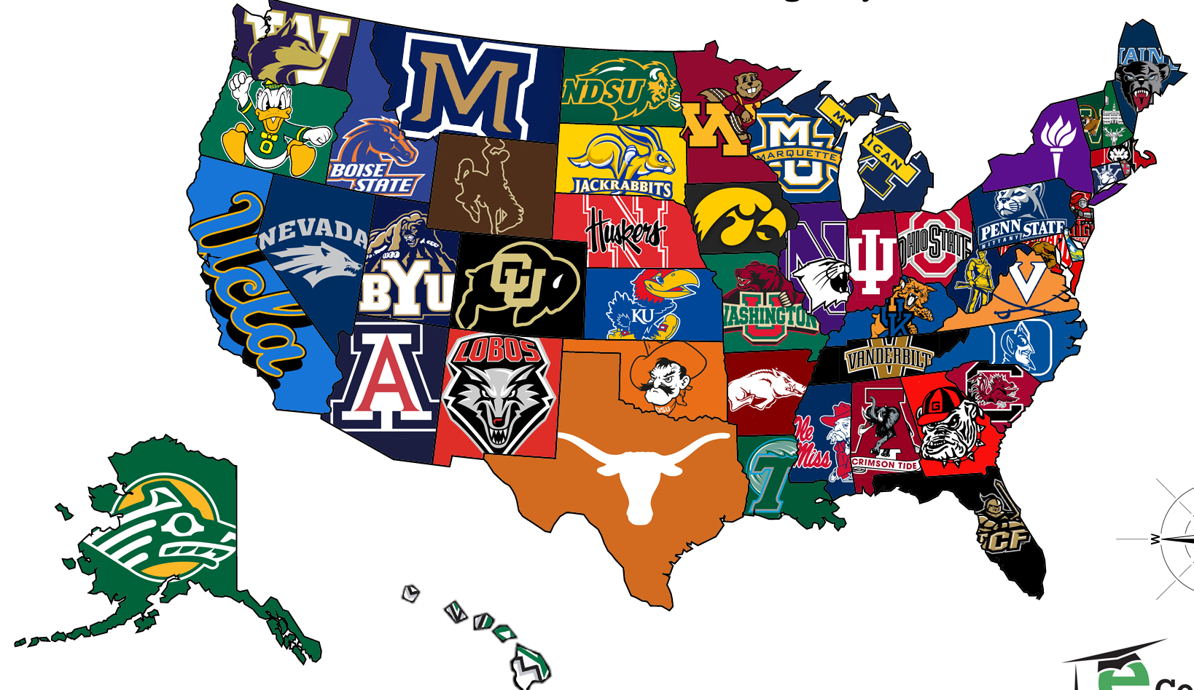
What does the future hold?

Slide 20
Contact Us
http://bespartansharp.weebly.com/

